Slide 1
Introducing
Q U E S T
A journey into the unknown, the choice is up to you
By Team CodeSaurus

Slide 2

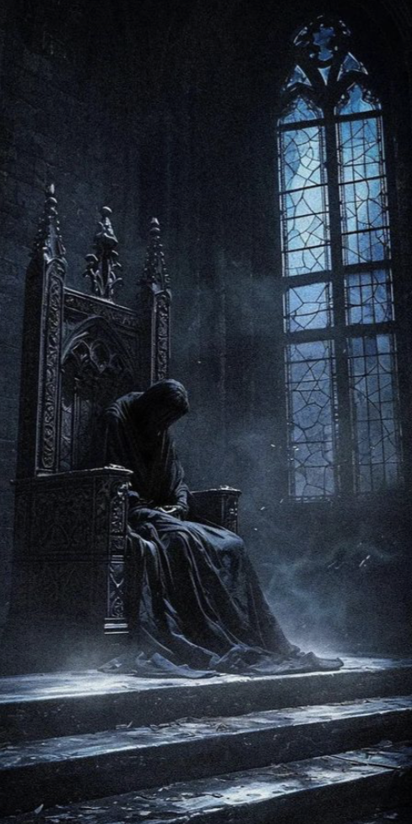



Encounter
the Lords
of Evil
Roll the dice,
Follow the story,
See where your choices lead you.
Or
delve
into a
magical
world
Or wander deep into the Dark Forest
Explore the world of Dragons

Slide 3
Agenda
Team Member Roles and Responsibilities
Problem Statement
Project Description
User Personas
MVP
Technologies and Algorithms
Project Schedule - Cadence
Team Working Agreement
Sprint 0 Retrospective

Slide 4
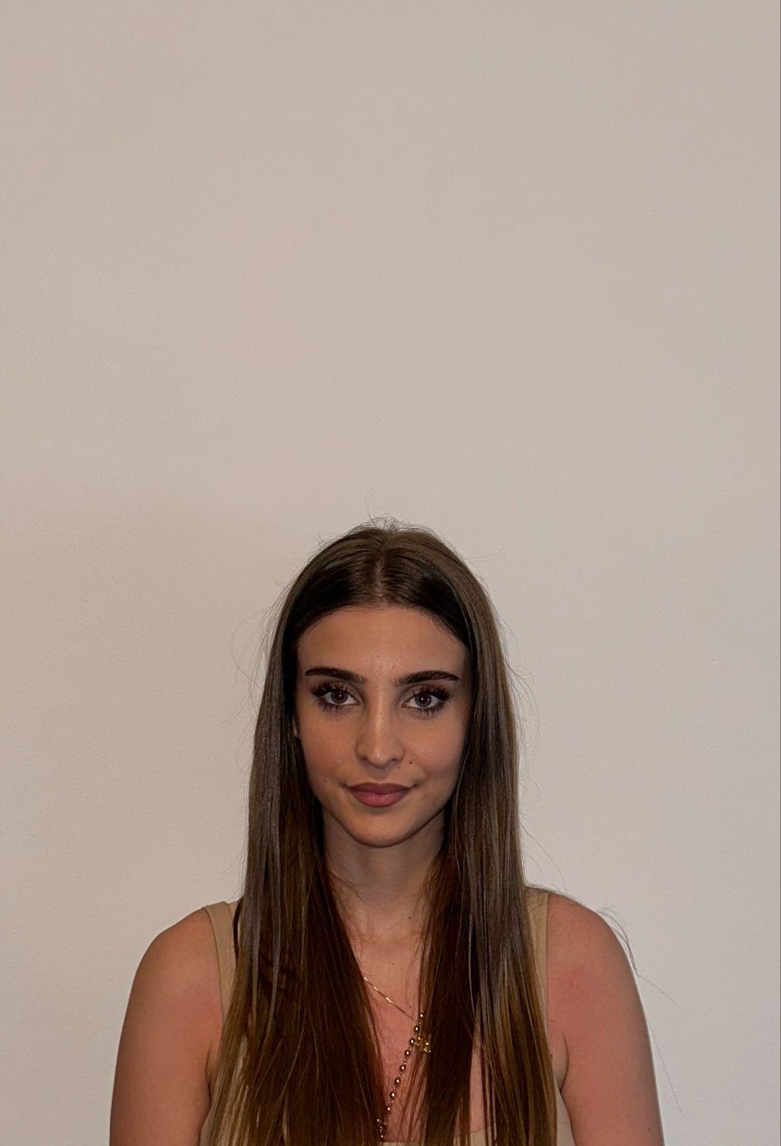
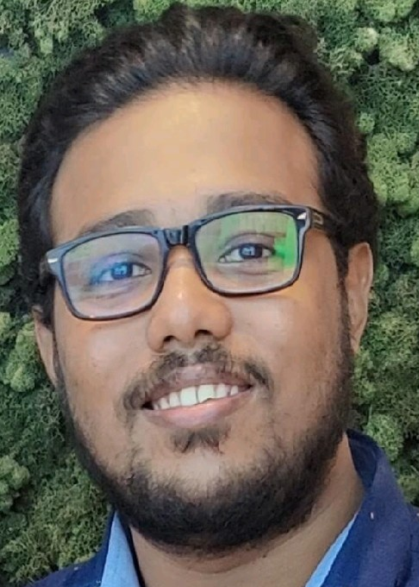
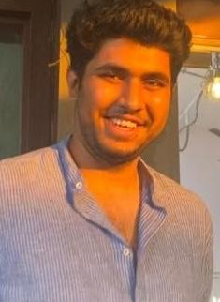
Getting to know the Team…
Ajla Hate
Clive Lewis
Dhruv Joshi
Backend Developer
Developer / Tester
Scrum Master / Developer

Slide 5
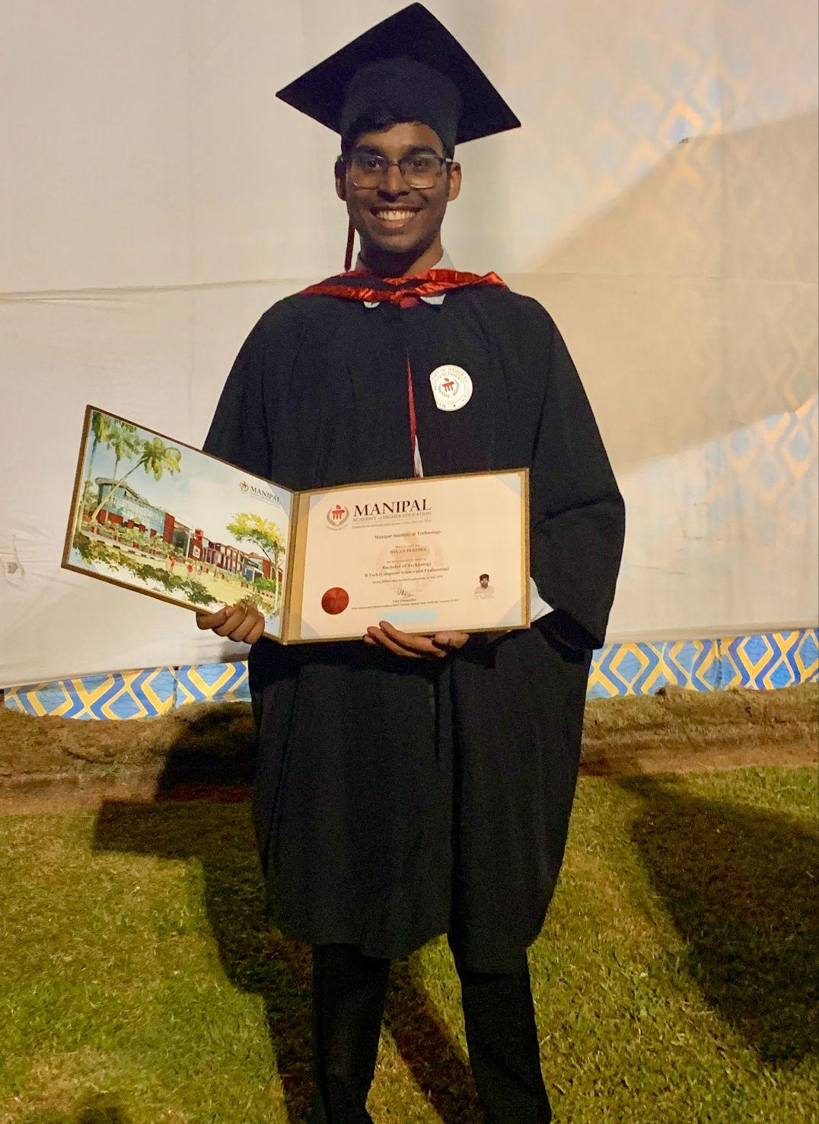

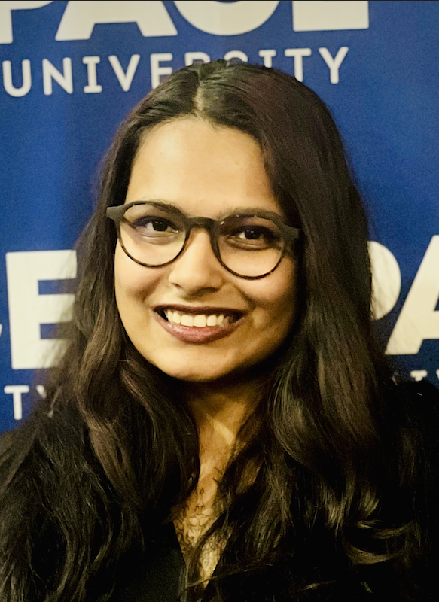
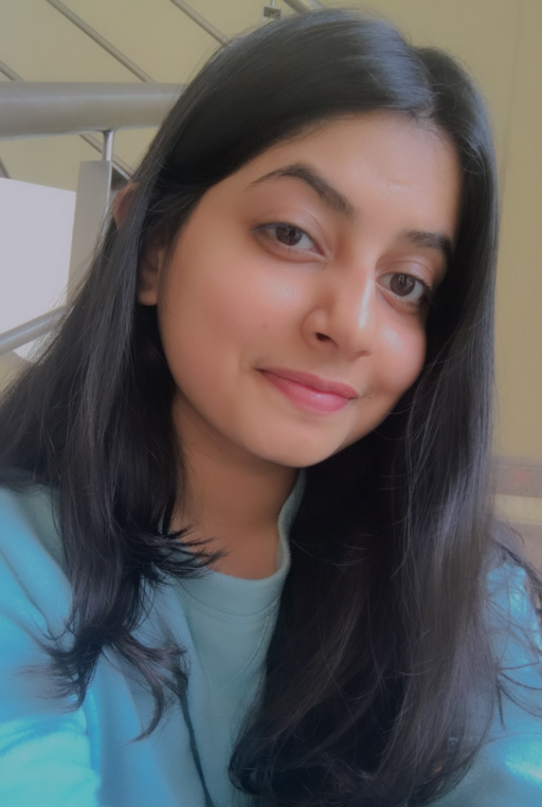
Getting to know the Team…
Dylan Pereira
Farham Khademi
Mrunmai Nagtode
Sharon Dsouza
Full Stack Developer
Team Lead / Developer
Developer / Tester
Full Stack Developer

Slide 6
What problem are we solving?
Limited flexibility in RPGs (Role Playing Games)
Lack of imagination/creative inspiration
Realization of a story that lives in your mind
Effective way to work through creative blocks
Quest tackles the challenges by using a gamified version of novel with simulations
Quest has the potential to make learning fun and engaging while boosting creativity and imagination.

Slide 7
Project Description
What is Quest?
Quest aims to be an interactive web-based platform to experience a novel
Allows users to dive into a thrilling world of imagination
Intended to blend compelling storytelling with player agency
Allows readers to shape the narrative by making choices that directly impact the story's progression
These choices can:
Influence character relationships
Change story outcomes
Provoke ethical dilemmas
Unlock secret plots

Slide 8

The Reader Persona
Name: Betty Thompson
Age: 41
Gender: Female
Occupation: Data Analyst
Betty is a mom, who enjoys reading romance novels in her free time. She often
finds herself wondering what it would feel like to be in one, living the story. She is part of a book
club where she and her friends analyze plots, characters, and alternate possibilities in stories.
Challenges:
- Finds most romance novels predictable, with similar plot structures and outcomes.
- Gets frustrated when the characters from the book make the same obvious decisions over and over.
- When discussing alternate “what-if” scenarios with her book club, it often leads to unresolved debates.
Goals:
- She enjoys the books but wants a way to interact with the story, without coming up with it from scratch.
- Wants to explore the ways in which a story can unfold if different choices were made even when plots remain the same.
- Seeks a fun way to test out all the theories in a way that can be shared with her book club friends.

Slide 9

The Novelist Persona
Name: John Olwen
Age: 36
Gender: Male
Occupation: Novel Writer
He is an old school writer who prefers a typewriter to a computer. John navigates the city using
public transport, always looking to be inspired by people and his surroundings. Like any writer,
John also struggles with creative aspects of his profession.
Challenges:
- He struggles with creative blocks while panning out one/more characters and their influence on the storyline.
- Struggles to discuss ideas with friends and colleagues due to worries about revealing too much, finds online resources overwhelming.
- Finds it hard to completely immerse himself into characters without letting his biases get in the way.
Goals:
- Seeks a discreet, interactive way to refine and navigate his story.
- Wants a way to explore characters with complex moralities without any personal bias or external judgement.
- Would consider using an online platform that has instructions and tutorials which are easy to follow and can guide him when he’s creatively stuck.

Slide 10

The Gamer Persona
Name: Jason Bourne
Age: 28
Gender: Male
Occupation: Associate Lawyer
He is a busy working professional, who looks forward to weekly game nights with his group
of friends. Enjoys online multiplayer games that are engaging, interactive and low effort.
Challenges:
- Struggles with finding new games that are different, can be played more than once/twice
before becoming boring and predictable.
- Finds it hard to schedule a day that works for everyone in the group for game night.
- When playing games that require storytelling and defining player roles, he and his group struggle to come up with something creative, especially after a long and busy work week.
Goals:
- Looking for a game that can be replayed fresh without getting predictable, can be one or multiplayer.
- Seeks a way to start game night without spending too much time in picking a game and setups.
- Wants to play in a dynamic environment that can easily adapt and improvise to player moves when the narrative gets overwhelming, with minimal effort required from players.

Slide 11








MVP
An AI-driven interactive novel with visual elements.
Dynamic Narratives - Users can shape the story.
Choice System - Type actions to interact with context.
Visual Elements - Enemy and NPC Portraits
Simple UI - Accessible to everyone
Pause/Resume - Continue Progress Anytime (TBD)
Notes:
NPC- nonplayer character

Slide 12












Technologies
Front - End
Back - End
Databases
Tools

Slide 13
Components
Player status manager: Keep track of player progress
Game status manager: Maintains game context data and behavior
AI LLM model manager: Generates dynamic narrative and dialogue
Prompt generator: Create efficient prompts with most relevant amount of metadata

Slide 14
Project schedule
Feb 12
March 12
April 9
April 30
Sprint 0
Sprint 1
Sprint 2
Sprint 3
Decide project topic
Finalize tech stack
Set up Jira for tasks
Create and update wiki page
Conduct retrospective
Plan project components
Plans user stories and tasks
Update wiki pages
Conduct retrospective
Development and integration of features
Update tech paper
Deploy a basic version of the app
Conduct retrospective
Culminate all work into the app
Integration
Finalize and update tech paper
Conduct retrospective
We’ve established a semi-weekly cadence to review progress and plan next steps (unless otherwise required).

Slide 15
Team Working Agreement
Communication Expectations
Communication/Collaboration Channels: Slack, Zoom Meetings, Emails, GitHub, Google Workspace.
All opinions and recommendations should be respected and taken into consideration during the decision making process.
In the event where a team member may want to divert away from a planned activity due to any reason, the team should be informed with a short description of the change on the communication channel.
In the event of an opinion based conflict both parties may list the respective research and solutions with regards to their respective opinions and the team may vote on majority to select the respective idea.
Each member is expected to voice their concerns with regards to any decision/change being made during the discussion process.
Each team members should update everyone on the communication channel when they push their code on Github to alert everyone and avoid merge conflicts as much as possible.
Any changes to the master branch must be informed to the team.
Meeting Schedule and Pattern:
Meetings will be scheduled twice a week (thrice in event of a recording to be produced) i.e. Sunday and Tuesday.
Time of the meetings to be decided based on an availability.
Meeting will have a fixed Agenda document to help team members prepare for the meeting items to be discussed.
Team members are encouraged to proactively schedule meetings to work and collaborate on their assigned work if required.
Sprint Plan will be devised in the first team meeting scheduled after a Sprint has been completed.
Last meeting of the sprint will be for retrospective.
Absence from a meeting must be informed in advance. The team member is expected to read the meeting summary posted in the channel, in order to work on assigned task.
Every team member is expected to actively participate in contributing each team meeting in their capacity.

Slide 16
Team Working Agreement
Team Dynamics And Principles:
Every team member should be treated with kindness, respect and patience even when it feels impossible.
Every team member clearly understands their responsibilities and tasks..
Workload will be distributed as evenly as possible. Single tasks with heavy workload may be broken down into smaller smaller manageable tasks.
Every task should have a deadline and a review on completion.
Every team member is encouraged to try and resolve blockers encountered and document their list of tried solutions before approaching the team.
Jira trackers should be updated regularly.
Work done should be linked to Jira tracker either in the form of a github commit id whenever possible.
Work should be updated/shared through GitHub.
Checklist for marking a Task as Completed:
Code should run without any form of syntactical or runtime errors.
Code should meet all acceptance criteria.
Work should be reviewed and tested by the assigned team member.
Code should be pushed to respective branch and appropriate pull request should be raised for review.
All relevant documentation should be tagged/updated alongside.
Work should be reviewed by multiple team members before Production is updated.

Slide 17
Sprint 0 retrospective
What went well?
Active participation brought diverse ideas and perspectives
Clear agendas ensured focused and time-efficient meetings
Polls facilitated decision-making when consensus was unclear
What could be improved?
Adhering to meeting durations better
Provide direct, personalized feedback to drive growth
Ensure clear, jargon-free communication for universal understanding
Our commitments
Enforce a code freeze before major deadlines for stability
Identify and mitigate potential risks early to avoid delays
Prioritize our sleep schedules, even if the deadlines disagree

Slide 18
Wiki page link
https://github.com/htmw/2025S-Codesaurus/wiki

Slide 19

Thank you

